Slide 1
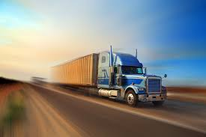
PRESENTED BY :
ABHISHEK BAGLA
KIRAN TRANSPORT PVT. LTD.
“Moves With Speed & Safety”

Slide 2
INTRODUCTION
The definition of transport : Trans means “across” and Port means “to carry” i.e carrying goods across the nation.
Transport helps in increase the demand for goods by extending the market boundaries nationwide.
Transportation is a critical factor in the economic growth and development as it accounts between 6% and 12% of the GDP.

Slide 3
ABOUT US
We are pleased to introduce ourselves as a premier transport contractor having fleet of trucks, trailers, tippers, loaders, crane operating since 1971.
We undertake transportation of normal truck/trailer consignments as well as heavy packages weighing upto 150M/Tons each.
We operate all over India, Nepal, Bhutan and Bangladesh border through road.

Slide 4
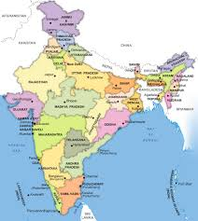
BRANCHES :
VAPI
BHIWANDI
PUNE
RAIPUR
BHOPAL / MANDIDEEP
CHENNAI
BANGALORE
ICCHAPURAM
DELHI
SILIGURI
ANKLESHWAR & BARODA
NASHIK
NAGPUR
INDORE
PONDICHERRY
HYDERABAD
COIMBATORE
KANPUR
KANDLA
BONGAON

Slide 5
Our key services :
KEY I – Full Truckload Throughout India
KEY II – Truck Load Across Borders Of Nepal, Bhutan, Bangladesh
KEY JJJ – Half Truck Load Clubbed With Other Materials
KEY JV – Project Cargo

Slide 6
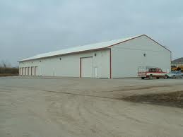
WAREHOUSING & CLEARING
We Provide :
Warehousing & Stocking Of Goods For Clients
Delivery & Distribution Of Goods From Godown To The Door Of Vendors
Clearing Of Goods At Docks & All Necessary Custom Formalities
Custom Clearance At Bangladesh, Nepal & Bhutan Borders
Labors, Crane, Hydra, Forklift etc. For Loading & Unloading Purposes As Per Demand Of Clients.

Slide 7
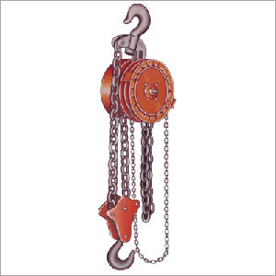
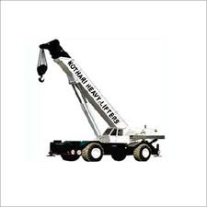
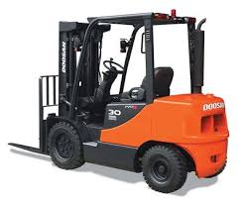
LOADING INSTRUMENTS
CHAIN PULLEY
CRANE
HYDRA
JCB
FORKLIFTER

Slide 8
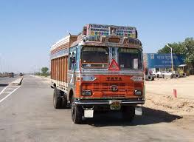
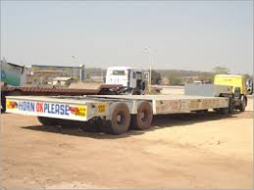
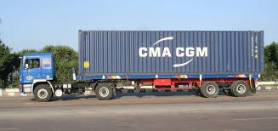
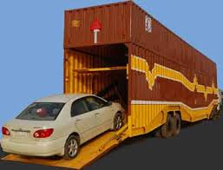
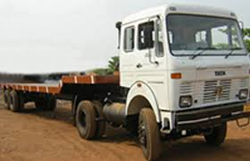
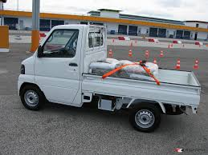
RANGE OF VEHICLES :
TRUCKS
TRAILERS
CONTAINERS
CAR CARRIER
OPEN DALA
LCVS

Slide 9
OUR CORPORATE CLIENT LIST :
M/s. Utkarsh Tubes & Pipes Ltd.
M/s. Wipro Ltd.
M/s. Surya Roshni Ltd.
M/s. Halonix Ltd.
M/s. B P Projects (P) Ltd.
M/s. Aster Ltd.
M/s. SRB Technocrat (P) Ltd.
M/s. Larsen & Toubro Ltd.,
M/s. Jyothy Laboratories Ltd.
M/s. Eveready Industries India Ltd.
M/s. Engineers India Ltd.
M/s. Precision Wires Ltd.
M/s. Kabra Extrusiontechnik Ltd.
M/s. Arya Filaments (P) Ltd.
M/s. Reliance Infratel Ltd. / Reliance Communication Ltd
M/s. TISCO Ltd.
M/s. New Tobacco Co. Ltd.
M/s. Atul Ltd.
M/s. Nilkamal Plastics Ltd.
M/s. Bartaman Ltd.
M/s. BASF India Ltd.
M/s. Century Denim
M/s. Shell Bitumen (I) Pvt. Ltd

Slide 10
WE DO NOT :
Provide Car Or Bus On Rentals.
Provide Courier Services.
Provide Loose Parcel Bookings (Ex: 1 or 2 Cbs)
Provide Animal Transfers.
Provide Oil Tankers.
Provide Refrigerated Vehicles.

Slide 11
Why kiran transport (P) LTD
We strict to our 3 pillars of strength i.e.
1.Safety of the material.
2.Alloted service time.
3.Best competitive prices.
We never tell lie or fool our clients if vehicle placement is delayed or failed.
We give our cent percent in resolving the problem without making extra profit as others.

Slide 12
ASKS
Manufacturing companies who strict to there payment terms Like –
Cement – Pipe – Chemicals -
RAMCO, ELECTROSTEEL BASF
INDIA, PSL LTD. CHANDRAS
KESORAM, JINDAL PIPE KANORIA
BINANI ALOM EXTRUSION QUACKER
ALL Trading company who gives advance payment –
All Taj members for there blind trust and cent percent faith upon KTPL for ther refrences.

Slide 13
THANKS
Last But Not The Least Our Company Is Registered With Just Dial As A Number One Transport Service Provider In Kolkata
One Can Also Find Us On Sulekha.Com & TradeIndia.Com

Slide 14
CONTACT DETAILS
Registered & Head Office :
KIRAN TRANSPORT PRIVATE LIMITED
P-16, New C. I. T. Road,
Kolkata - 700 073.
Tel: (033) 2236-8083; 2237-3733
Fax: (033) 2237-4382
Mobile :9331063450
e-mail: baglas@cal.vsnl.net.in

